Slide 1
MUNCH
Pitch Deck
Jefferey, Topher, Gabriel, Mike, Cho

Slide 2
Table of contents
01
02
03
04
05
06
The Problem
Our Solution
Proposed UI/UX
Backend
Dataset
Questions?

Slide 3
01
The Problem

Slide 4
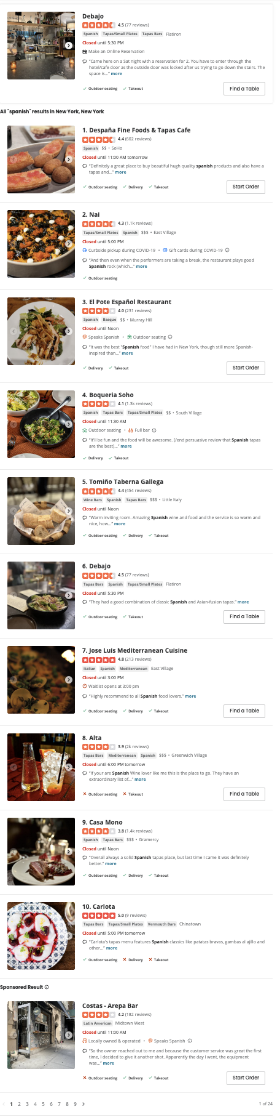
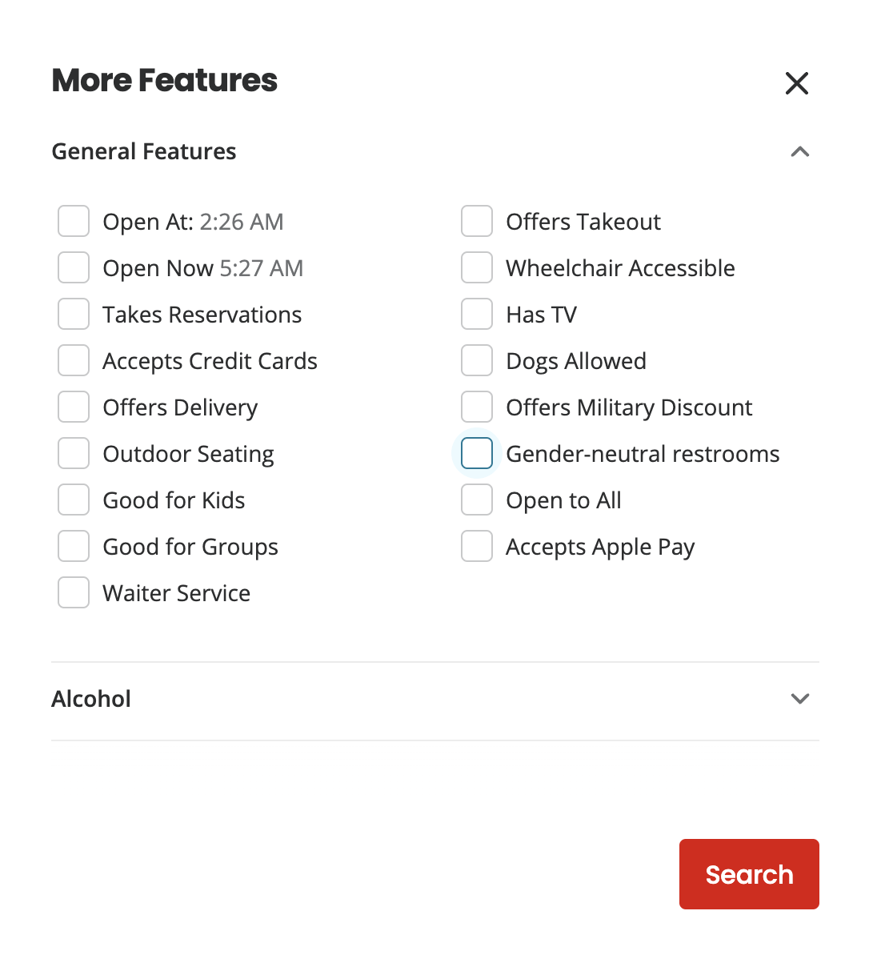
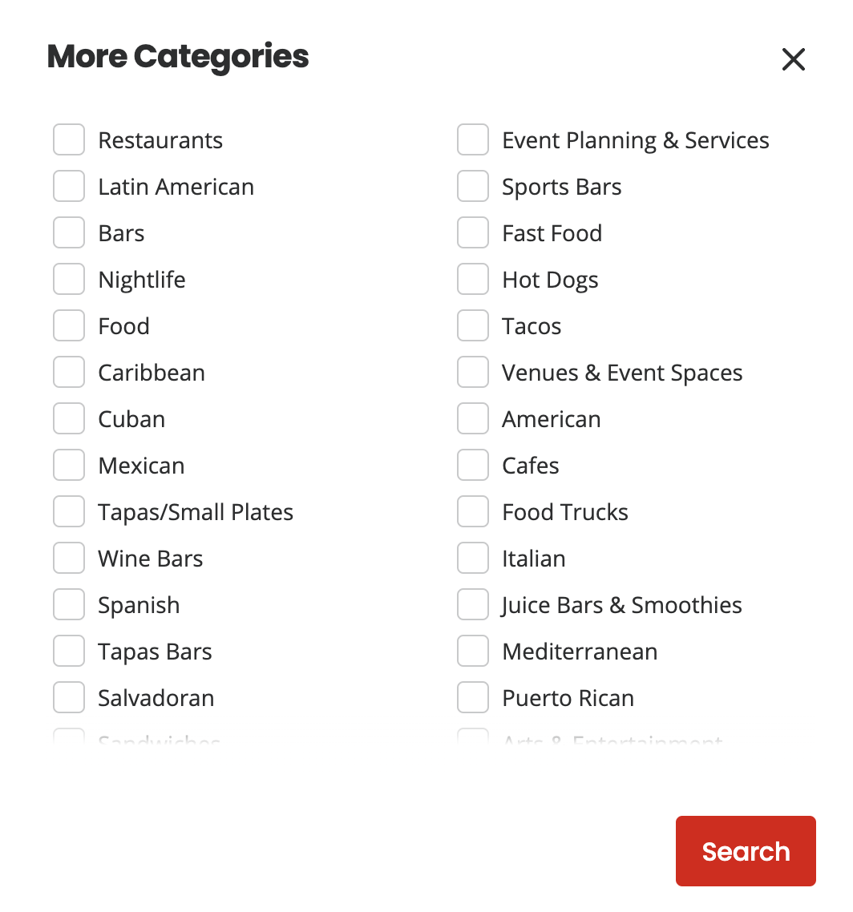
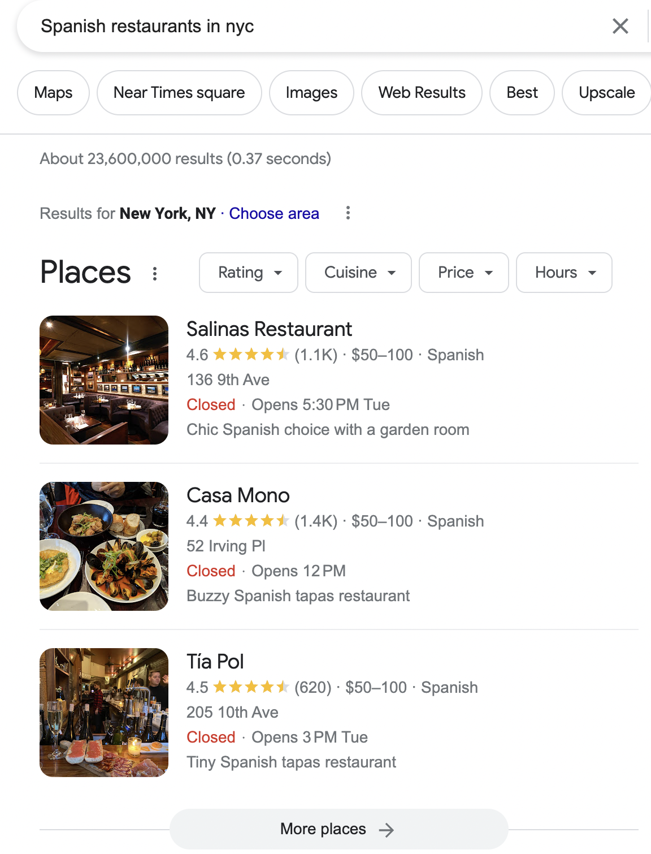
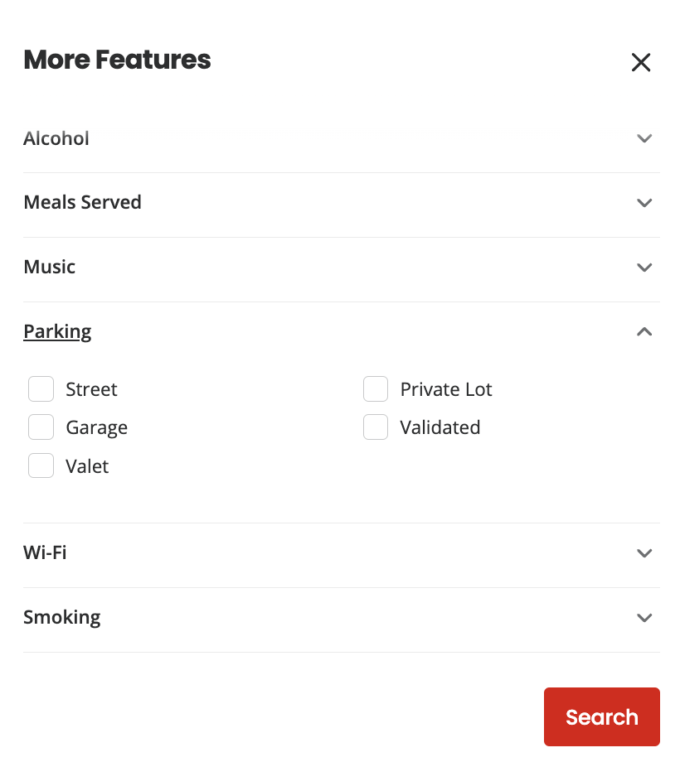
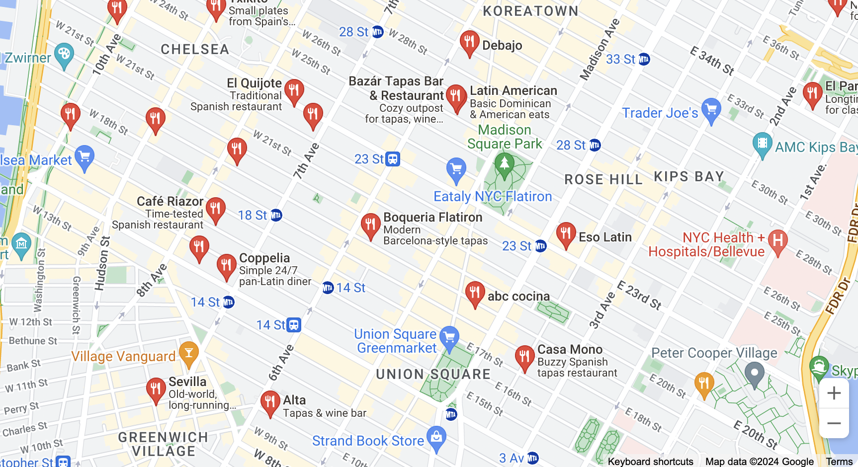
The Problem

Slide 5
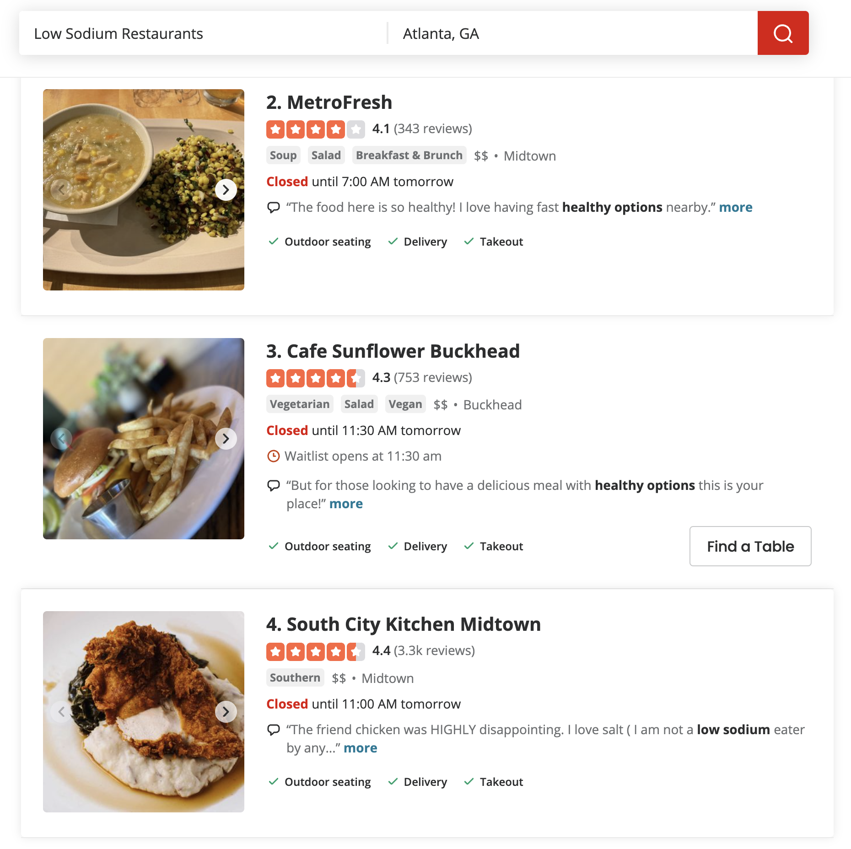
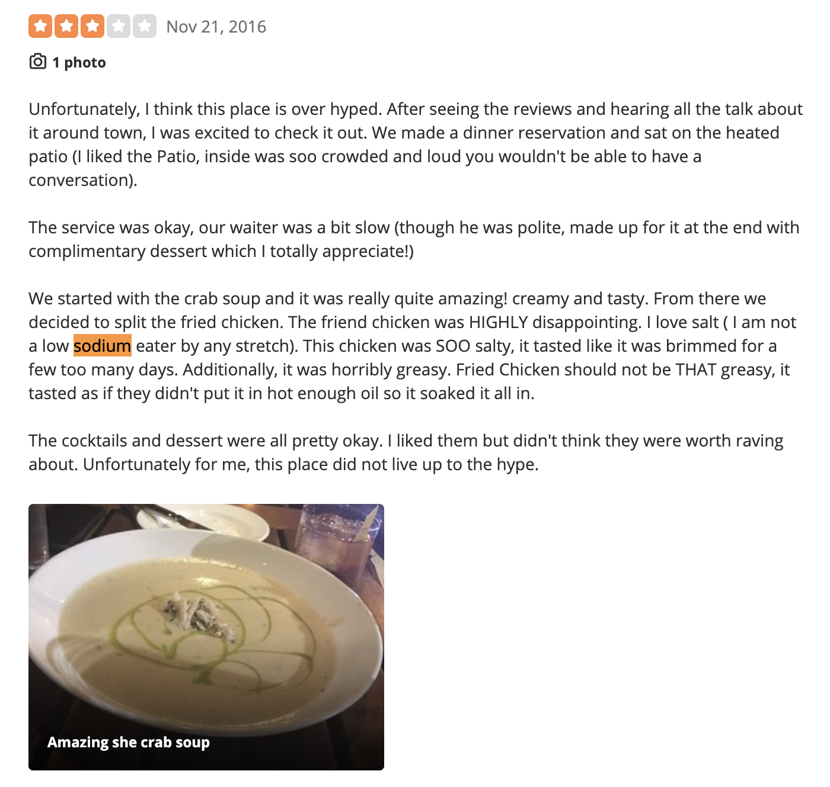
Poor Review Retrieval - Using Basic Keyword Search

Slide 6
02
The Solution

Slide 7




Key Features
+
Restaurant Search
Conversational
Flexible LLM Search to quickly find restaurants
Narrow down the search
Talk to the AI and ask questions back and forth
Very specific queries

Slide 8
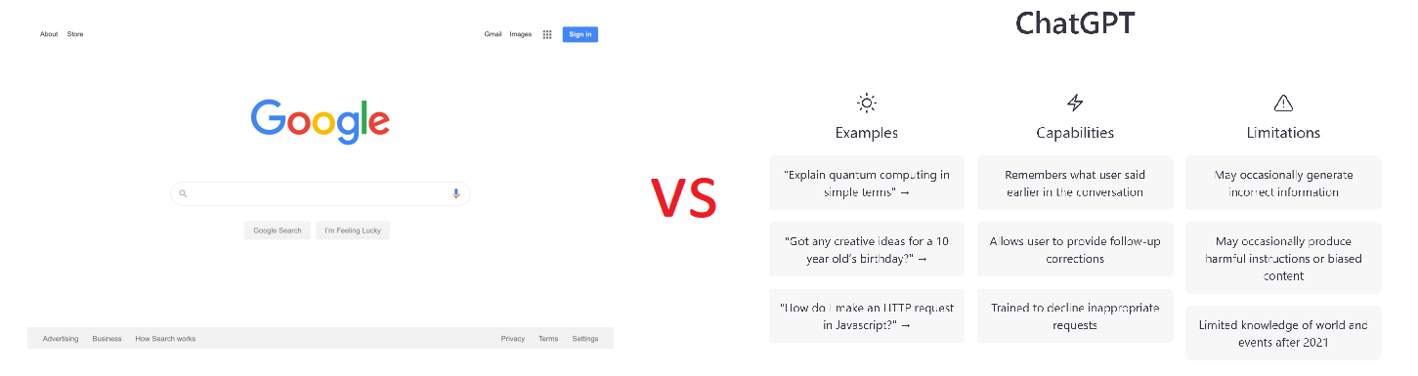
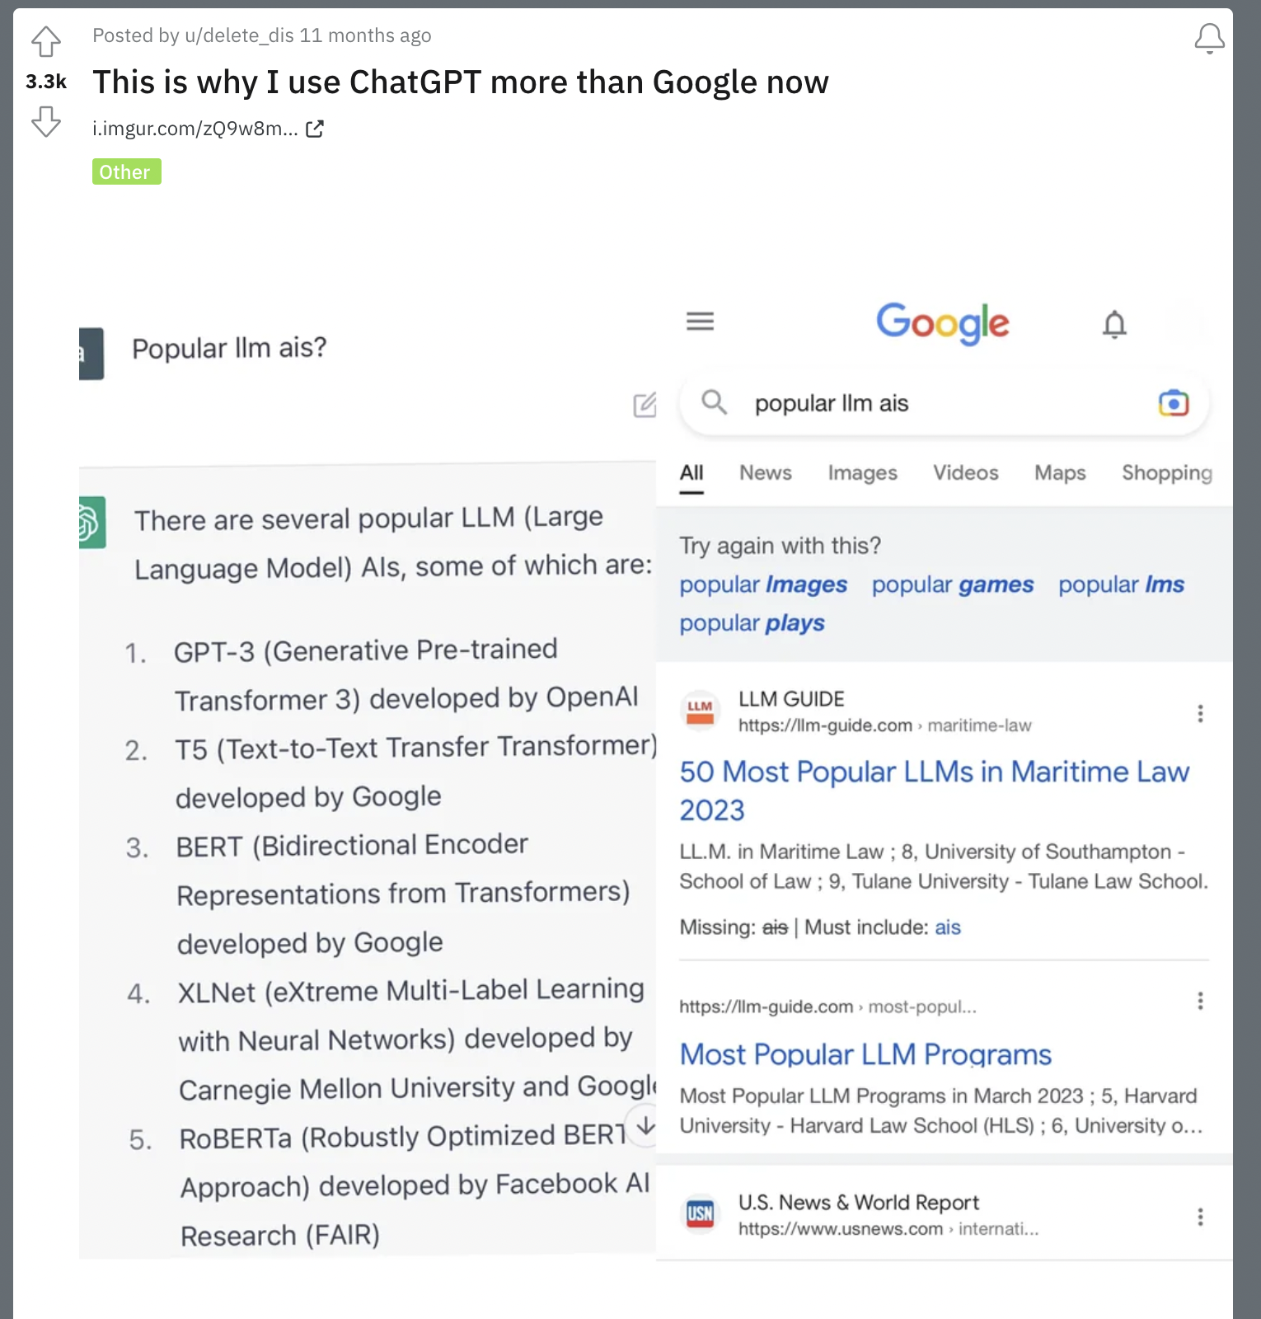
Google Search vs ChatGPT Search
Why not for restaurant search?

Slide 9
03
Proposed UI/UX

Slide 10
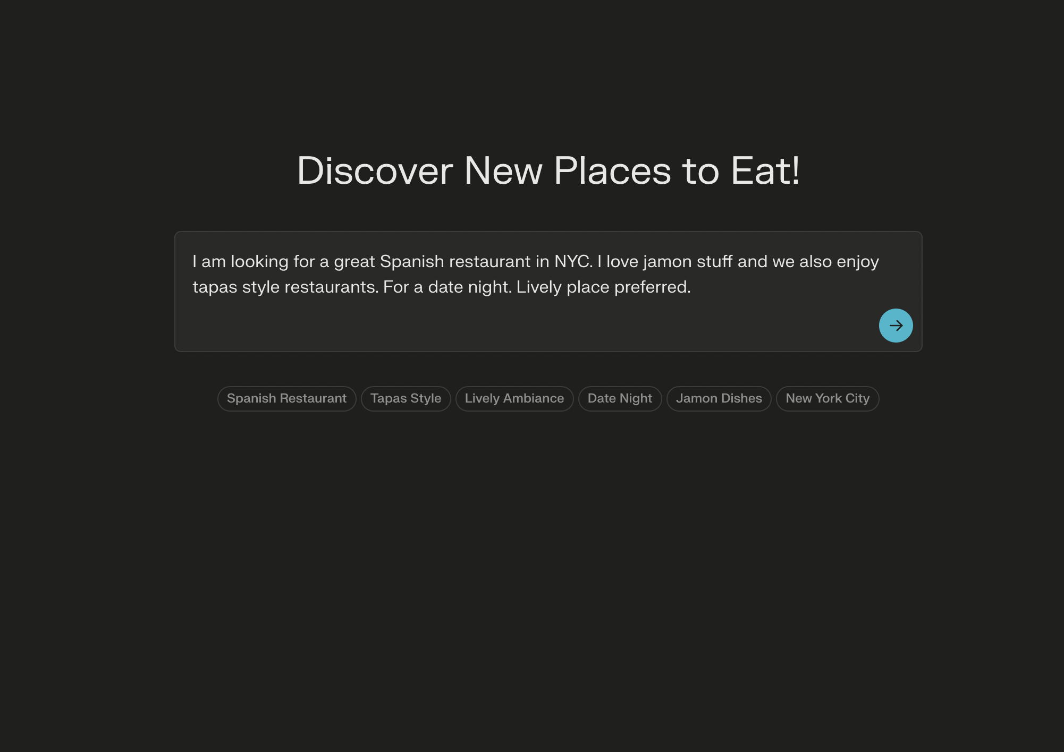

Slide 11


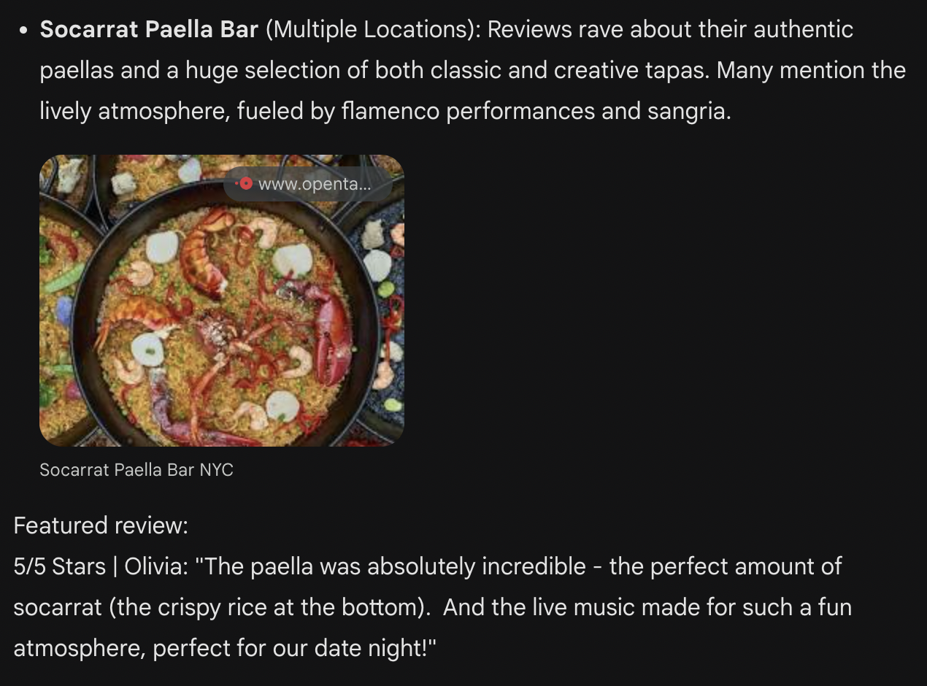
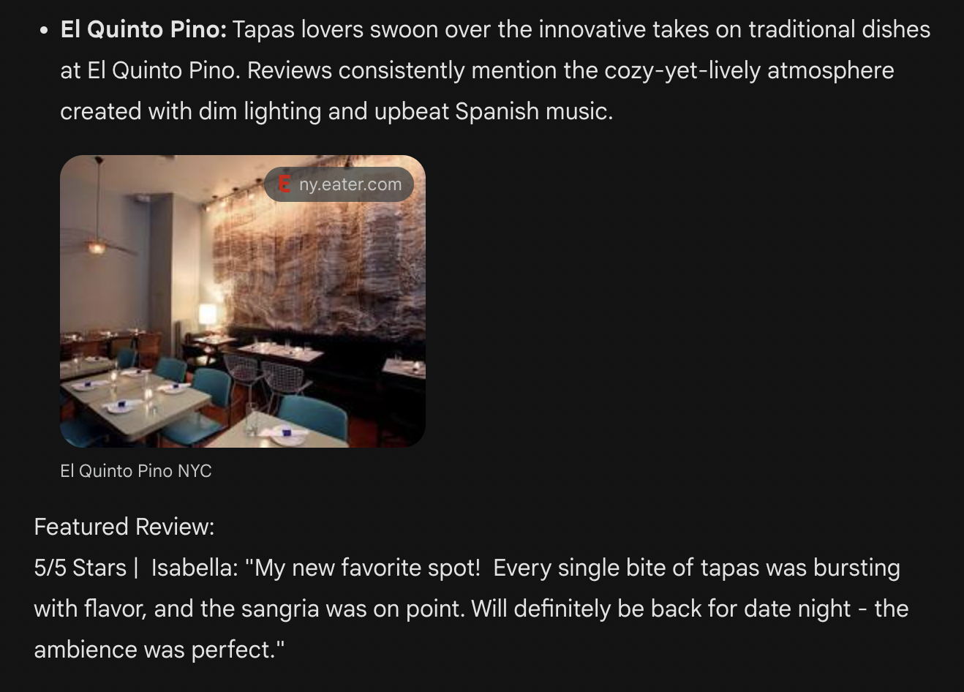

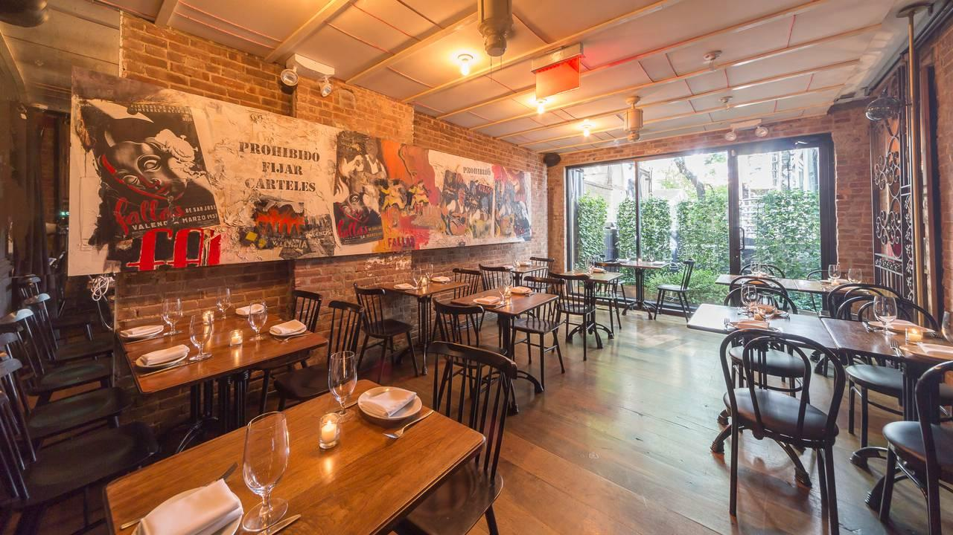


Example Search Results

Slide 12
04
Backend

Slide 13


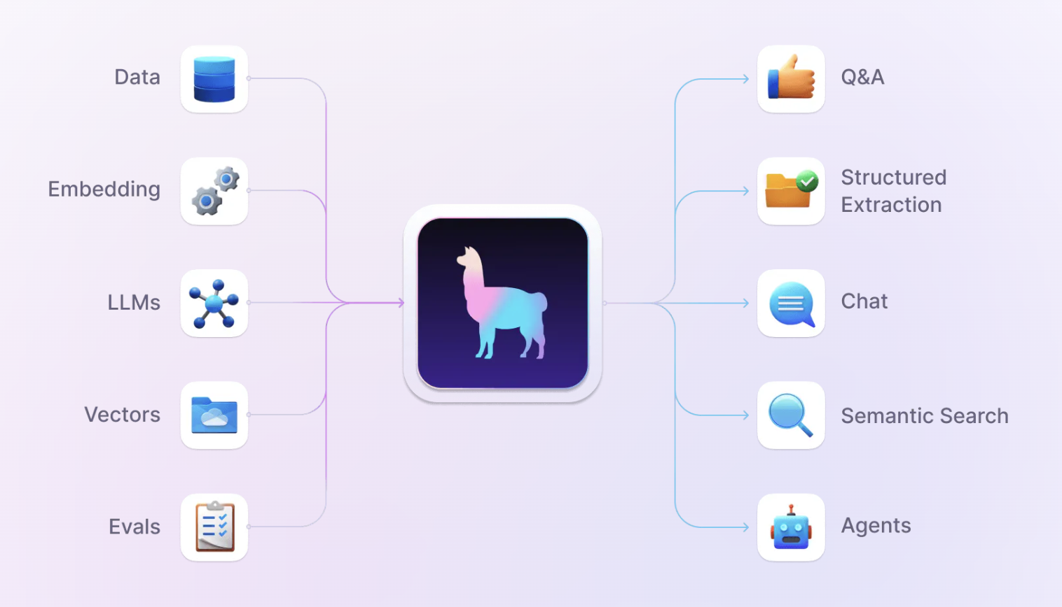
GPT Agent, RAG, and Function Calling
+

Slide 14


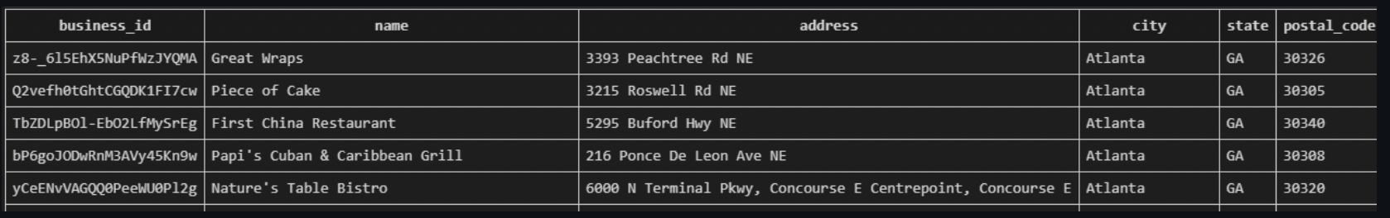

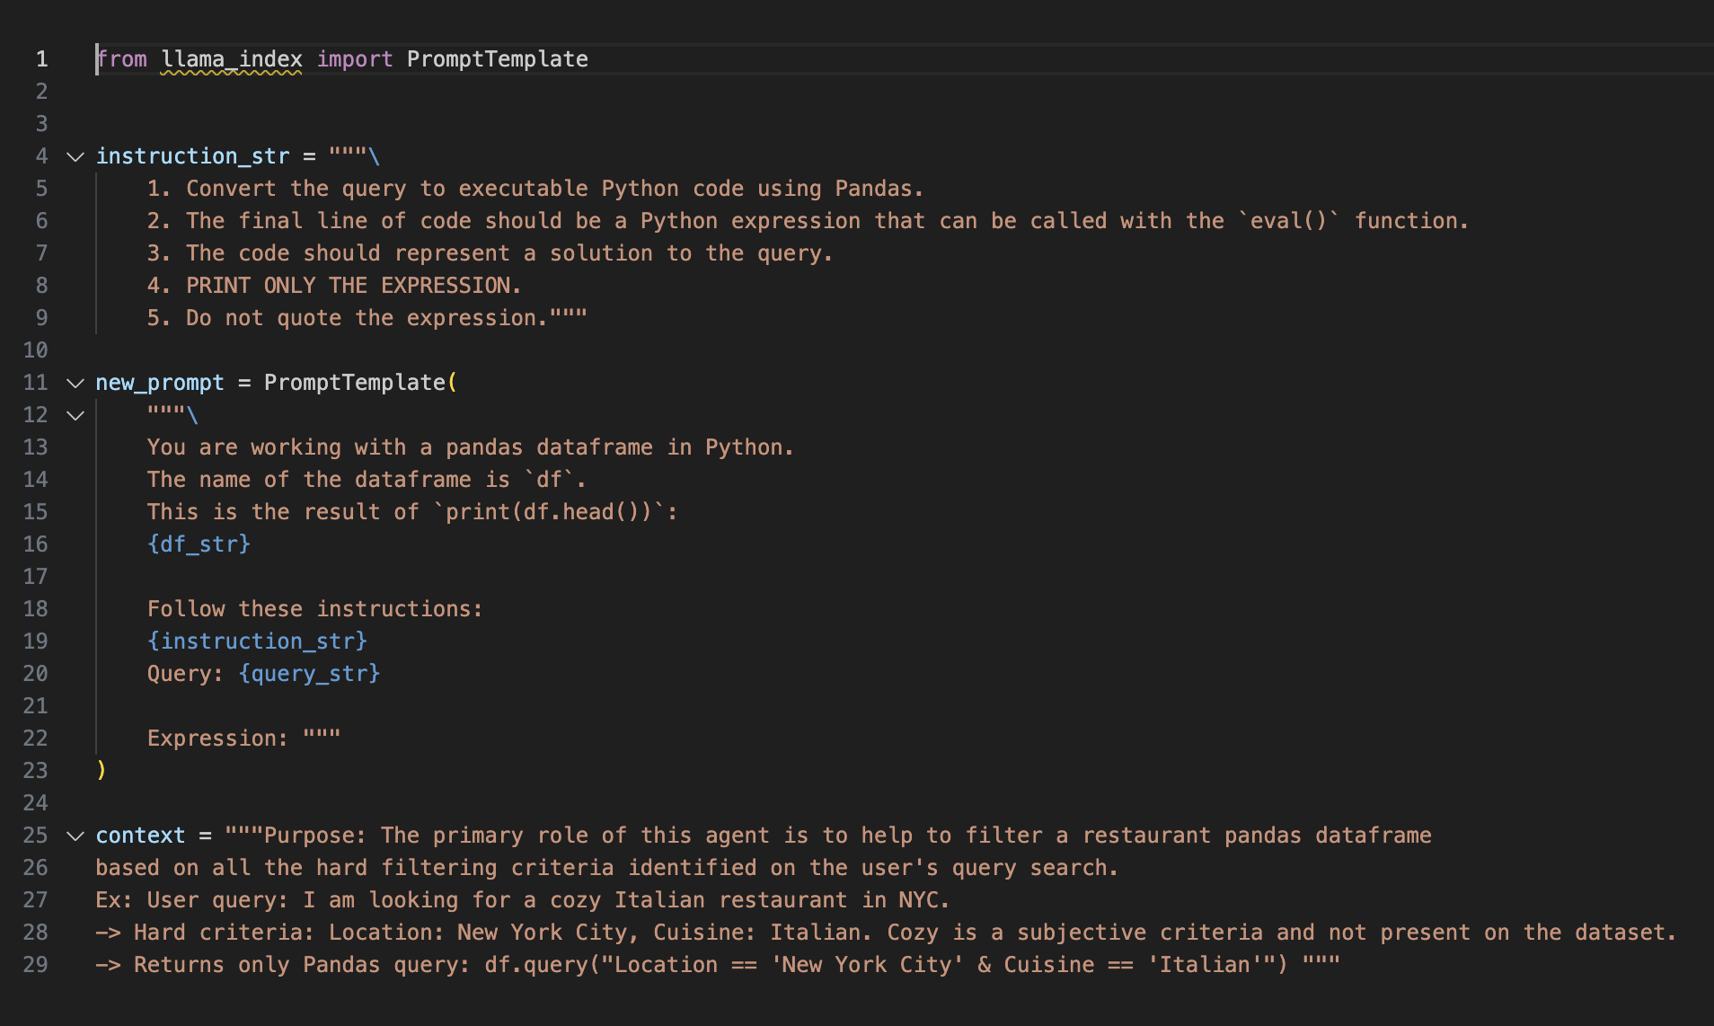
Database Filtering from Natural Language Query
Step 1: Send to GPT4:
User’s query
Database schema
Special prompt
Step 2: GPT4 returns to the backend only the custom pandas code necessary to perform the filtering.
Step 3: Llama Index’s agent executes the code, filtering the dataset to only include Tapas Style Spanish restaurants in NYC, that have Jamon as a menu item.

Slide 15

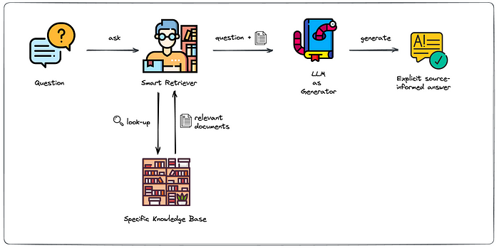
Retrieval Augmented Generation (RAG)
Step 1: Embed and index our entire restaurant review dataset.
Step 3: Our RAG pipeline then sends all the relevant restaurant/review information and rankings back to our GPT4 agent, and he crafts the final response for the user, based on that data.
Step 2: After user sends restaurant search query, smart retriever compares it with all restaurant reviews to find similarity score between them.

Slide 16

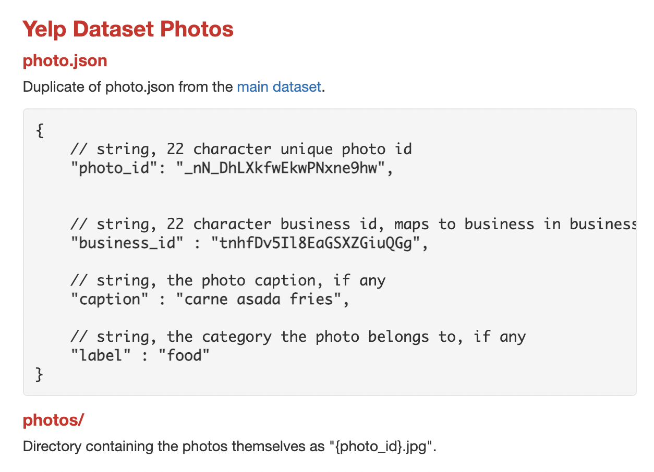
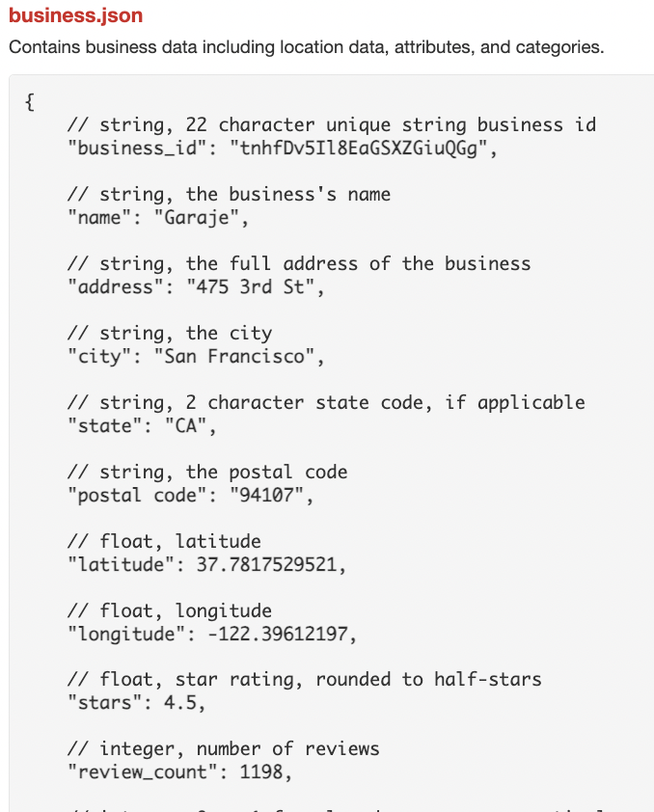
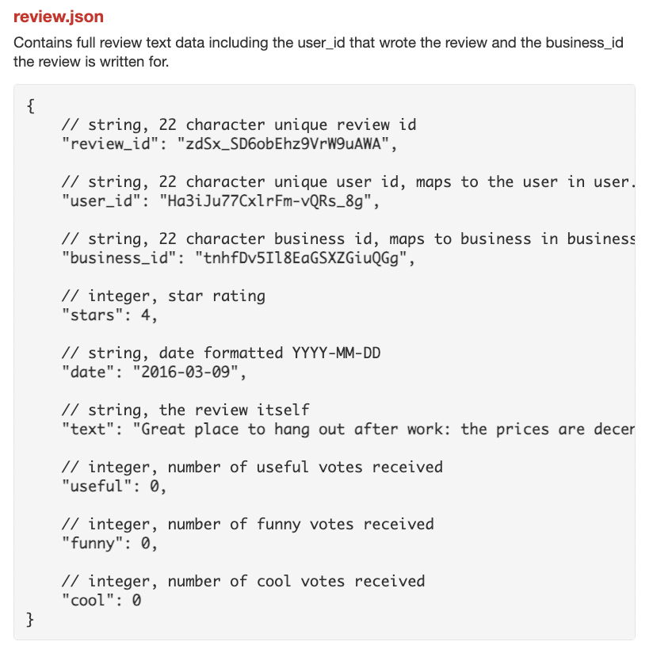
Temporary Dataset - For Proof of Concept

Slide 17
Thanks!
Do you have any questions?

